Slide 1
OPIM 5604
Predictive Modeling
Model Performance Metrics - Classification
Jennifer Eigo, Instructor in-Residence

Slide 2
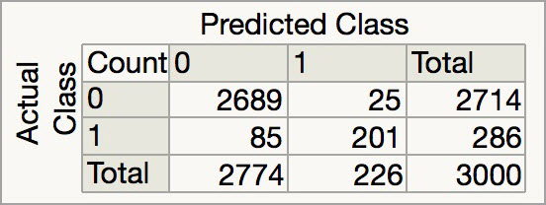
Confusion Matrix
A grid that crosses actual categories with predicted categories.
Each number in the matrix corresponds to a count of rows that meet the criteria.
NOTE: Pay careful attention to the labels on the matrix because actual and predicted can be reversed.

Slide 3
Confusion Matrix
True Positives = When a record is actually a 1 and you predict a 1
True Negatives = When a record actually is a 0 and you predict a 0
False Positives = When you predict a 1 but the record is actually a 0
(Also called a Type I error)
False Negatives = When you predict a 0 but the record is actually a 1
(Also called a Type II error)

Slide 4
Confusion Matrix
TP = 201
TN = 2689
FP = 25
FN = 85
Total Records = 3000

Slide 5
Accuracy Measures
Total Accuracy = How many predictions did the model get right?
= (TP + TN)/Total Records
= (201 + 2689)/3000
= 96.3%
Accuracy of the 1 Prediction = When the model predicts a 1, how often is it correct?
= TP/(TP + FP)
= 201/(201 + 25)
= 88.9%

Slide 6
Accuracy Measures
Baseline Accuracy = How often do 1s occur in real life? We know this before any modeling is done.
= (TP + FN)/Total Records
= (201 + 85)/3000
= 9.5%
Lift = How much better is the response rate when I predict a 1 compared to the baseline?
= Acc of 1/Baseline
= 88.9%/9.5%
= 9.4

Slide 7
Sensitivity, Specificity, PPV
Sensitivity = How many of the actual 1s can my model correctly identify?
= TP/(TP + FN)
= 201/(201 + 85)
= 70.3%
Specificity = How many of the actual 0s can my model correctly identify?
= TN/(TN + FP)
= 2689/(2689 + 25)
= 99.1%

Slide 8
Sensitivity, Specificity, PPV
Positive Predictive Value = When the model predicts a 1, how often is it correct?
= TP/(TP + FP)
= 201/(201 + 25)
= 88.9%
This is the same thing as the Accuracy of the 1 Prediction.

Slide 9
Precision and Recall
Precision = When the model predicts a 1, how often is it correct?
= TP/(TP + FP)
= 201/(201 + 25)
= 88.9%
This is the same thing as the Accuracy of the 1 Prediction.
This is also the same thing as the PPV.

Slide 10
Precision and Recall
Recall = How many of the actual 1s can my model correctly identify?
= TP/(TP + FN)
= 201/(201 + 85)
= 70.3%
This is the same thing as the Sensitivity.

Slide 11
F1 Score
F1 Score = The harmonic mean of Precision and Recall
= 2 * (Precision * Recall) / (Precision + Recall)
= 2 * (0.889 * 0.703) / (0.889 + 0.703)
= 2 * (0.625) / (1.592) = 0.789
The F1 Score will be between 0 and 1.
  A high F1 means both precision and recall are high.
  A low F1 means both are low.
  A mid-range F1 means one is high and the other is low.

Slide 12
Decisioning Approach
What if there is an imbalance in the cost of errors?
Estimate costs of FP and FN and calculate the model’s cost of mistakes
If FP = $12 and FN = $0.20
Cost = (12 * 25) + (.2 * 85) = 300 + 17 = $317

Slide 13
Changing the Cut-off
Many classification models a probability of class membership, not class directly
Assign a cut-off
Default cut-off is 0.50
But different cut-offs can improve model performance
If Probability >= cut-off then predict outcome = 1
If Probability < cut-off then predict outcome = 0

Slide 14
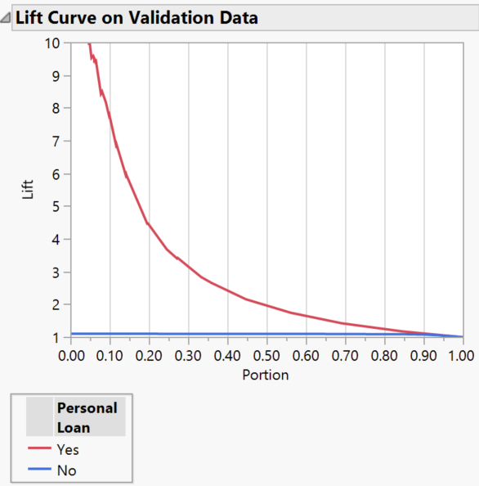
Lift Curve
Helps you choose a cutoff
Plots lift at every possible portion of data from 1 to 0
Used mainly for choosing
the group most likely to
have a certain outcome
Example: If I market to the
top 10% of my leads, I would
expect a lift of about 7.5
over my baseline.

Slide 15
Lift Curve
Example: If my baseline is 2%
and I target the top 30%,
what is my new expected
response rate?
Ans: 6%
Example: If my current
response rate is 10% and I
need 50%, what portion
should I target?
Ans: ~16%

Slide 16
Receiver Operating Curve (ROC)
This is a way to measure performance of a model at all possible cutoffs between 1 and 0.
If you use a cutoff of .95 you will make very few FP errors but will find only some of the TPs. If you make the cutoff .5 you will find more TPs and make more FP errors. If you make the cutoff .05 you find many TPs but will also make many FP errors.
The fewer FPs your model makes across all cutoffs, the larger the Area Under the Curve (AUC), and the better the model.

Slide 17
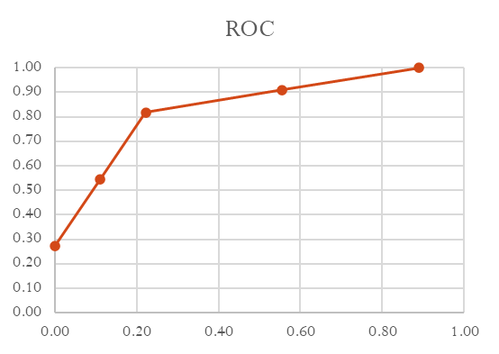
Receiver Operating Curve (ROC)
Record | Acutal | Model Output | Cutoff .9 | Cutoff .7 | Cutoff .5 | Cutoff .3 | Cutoff .1
1 | N | 0.05 | N | N | N | N | N
2 | N | 0.1 | N | N | N | N | Y
3 | N | 0.15 | N | N | N | N | Y
4 | Y | 0.2 | N | N | N | N | Y
5 | N | 0.25 | N | N | N | N | Y
6 | N | 0.3 | N | N | N | Y | Y
7 | N | 0.35 | N | N | N | Y | Y
8 | Y | 0.4 | N | N | N | Y | Y
9 | N | 0.45 | N | N | N | Y | Y
10 | Y | 0.5 | N | N | Y | Y | Y
11 | Y | 0.55 | N | N | Y | Y | Y
12 | N | 0.6 | N | N | Y | Y | Y
13 | Y | 0.65 | N | N | Y | Y | Y
14 | Y | 0.7 | N | Y | Y | Y | Y
15 | Y | 0.75 | N | Y | Y | Y | Y
16 | N | 0.8 | N | Y | Y | Y | Y
17 | Y | 0.85 | N | Y | Y | Y | Y
18 | Y | 0.9 | Y | Y | Y | Y | Y
19 | Y | 0.95 | Y | Y | Y | Y | Y
20 | Y | 0.99 | Y | Y | Y | Y | Y
X axis
Y axis
 | False Positives | % of Total N Incorrectly Identified | True Positives | % of Total Y Correctly Identified
Cutoff .9 | 0 | 0.00 | 3 | 0.27
Cutoff .7 | 1 | 0.11 | 6 | 0.55
Cutoff .5 | 2 | 0.22 | 9 | 0.82
Cutoff .3 | 5 | 0.56 | 10 | 0.91
Cutoff .1 | 8 | 0.89 | 11 | 1.00
Actuals:
11 Ys 9 Ns

Slide 18
Classification Summary
Total Accuracy gives an overall view of the model performance but doesn’t give any insight into the types of mistakes your model is making.
Baseline Accuracy is simply how often does the target event occur in real life. We can calculate this based on the actual values in our target variable before doing any modeling work at all.
Accuracy of the 1 Prediction = Positive Predictive Value = Precision
  These metrics tell us how much we can trust the 1 prediction.

Slide 19
Classification Summary
Lift is a comparison of the expected response rate from the people our model identifies with the baseline expected response rate. Say the lift is 5 and our baseline is a 10% response rate. If we use our model to identify just the right people, we would expect a 50% response rate.
Sensitivity = Recall
  These metrics tell us how many of the target class are correctly identified by the model
  Models with high sensitivity and low specificity are good at identifying the target class (true positives), but will have many false positives too.

Slide 20
Classification Summary
The cost of misclassification mistakes often differ depending on the business scenario.
Think of cancer screening. A FN means we tell someone they don’t have cancer even though they actually do. So we would rather have a FP where we send someone for follow up tests even though they don’t actually have cancer. A FN could cost someone their life whereas a FP could just be the cost of an additional test. In situations like this we would want a model with very high Sensitivity or Recall. Here, those are more important than Total Accuracy.

Slide 21
Classification Summary
A high F1 Score tells us that our model is good at finding a lot of the 1s and most of the 1 predictions are correct. When the F1 Score lowers, we need to look at Precision and Recall separately to know what is bringing it down.

Slide 22
Classification Summary
AUC and the Lift Curve show information across all possible cut-offs
The Lift Curve shows the expected lift for all the possible proportions of data in the sample. From there you can derive the associated cutoff to use.
The AUC is calculated based on all possible cutoffs for a model. All the other performance metrics require you to first set the cutoff, then measure performance based on the confusion matrix that results from that cutoff.

